Slide 1


Alternate uses for map2loop/model outputs An iron ore prospectivity example
Mark Lindsay, CSIRO Mineral Resources
6IAS
3D modelling and Loop workshop
Saturday 22nd July, 2023

Slide 2

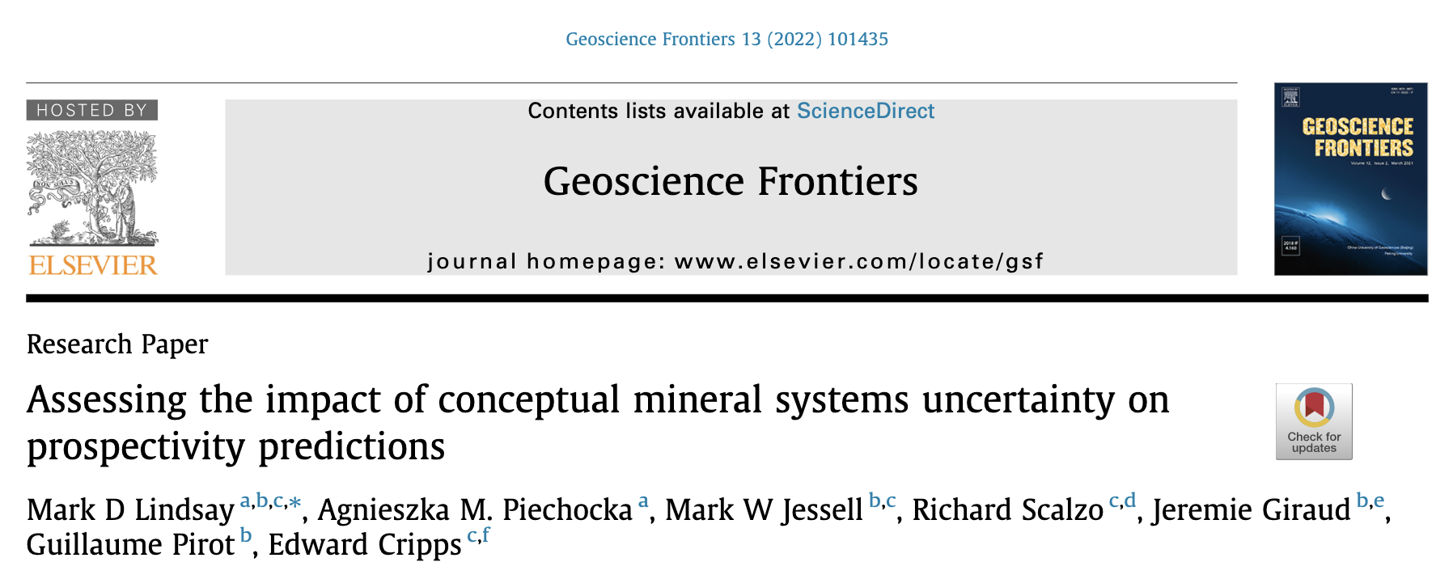




Acknowledgements
MRIWA Project 557 “Iron Ore – Hamersley Province, WA”

Slide 3
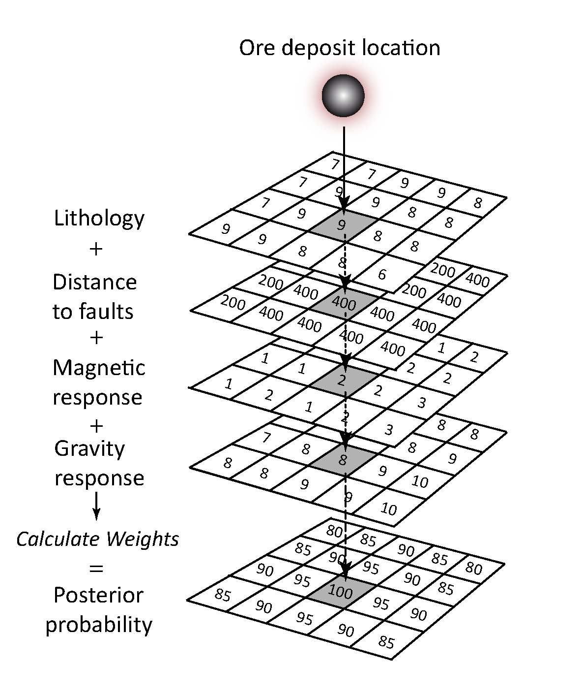

Concepts to models
Mineral exploration begins with:
Business strategy
Creation/application of targeting model
Follow-up detection in high priority domains
Geoscience challenge:
Conceptual targeting ->
De-risk
Cost-effective detection
Codifying exploration knowledge
Tacit -> models
Hronsky & Groves 2008
From Lindsay et al 2014

Slide 4
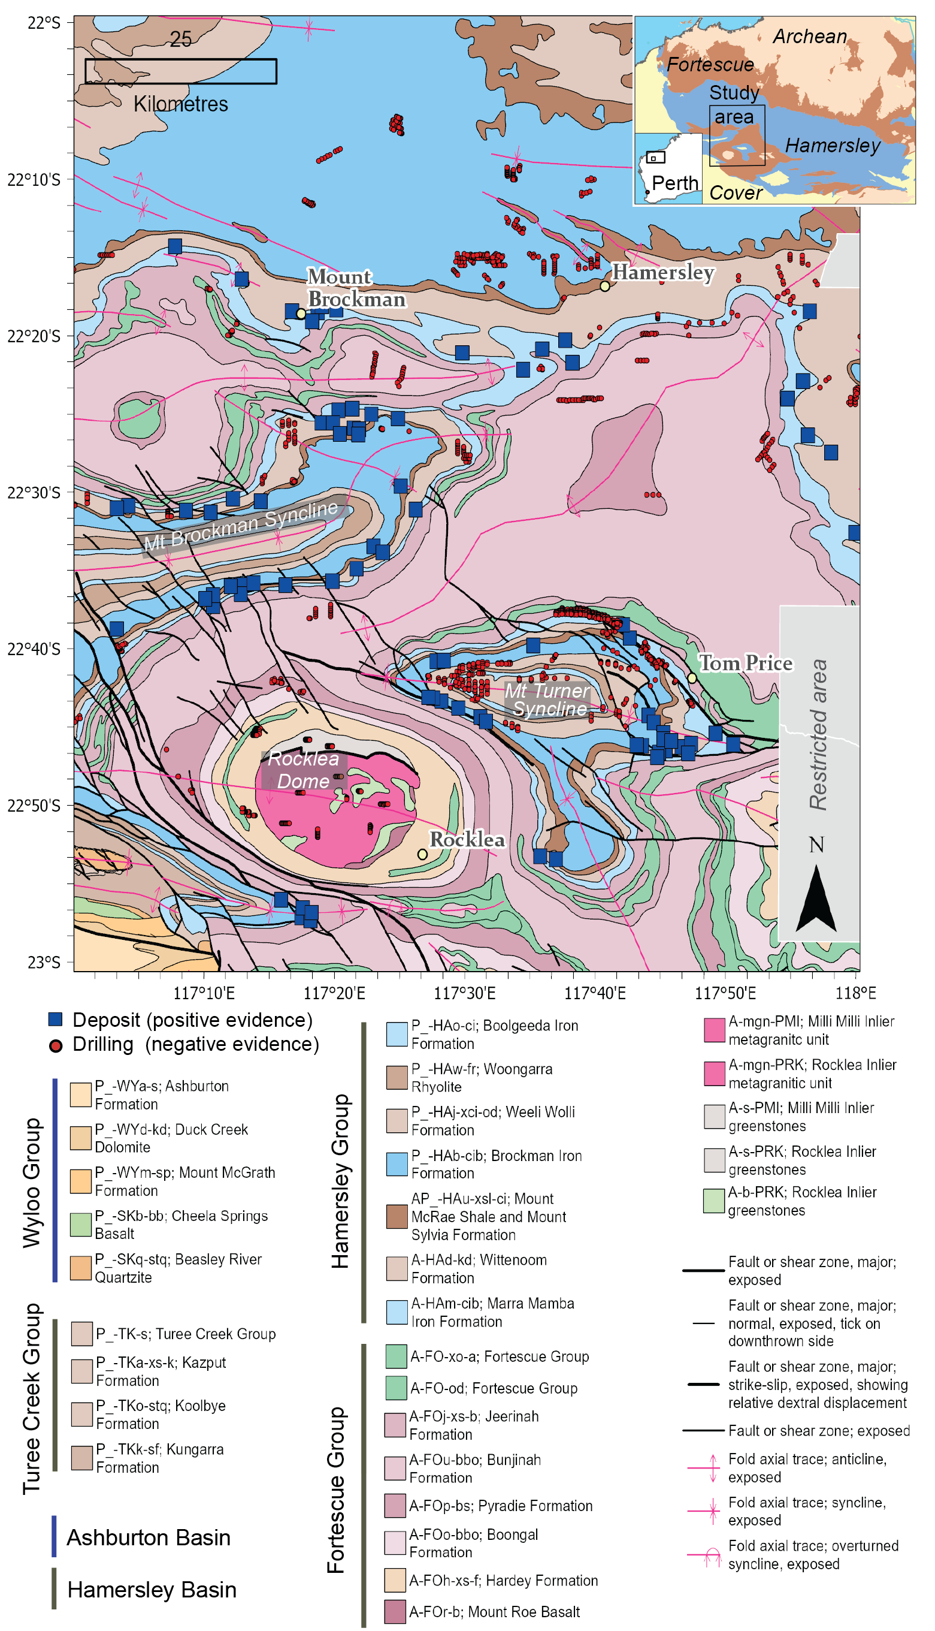
Geological Context
Pilbara Craton, Western Australia
Mt Bruce Supergroup overlying Archean gneisses / greenstones
Hamersley Group
Marra Mamba / Brockman Iron Formations - ~ 50B Tonnes
Deformation more intense to south

Slide 5
Training Set
Careful QAQC on deposit and drilling locations

Slide 6
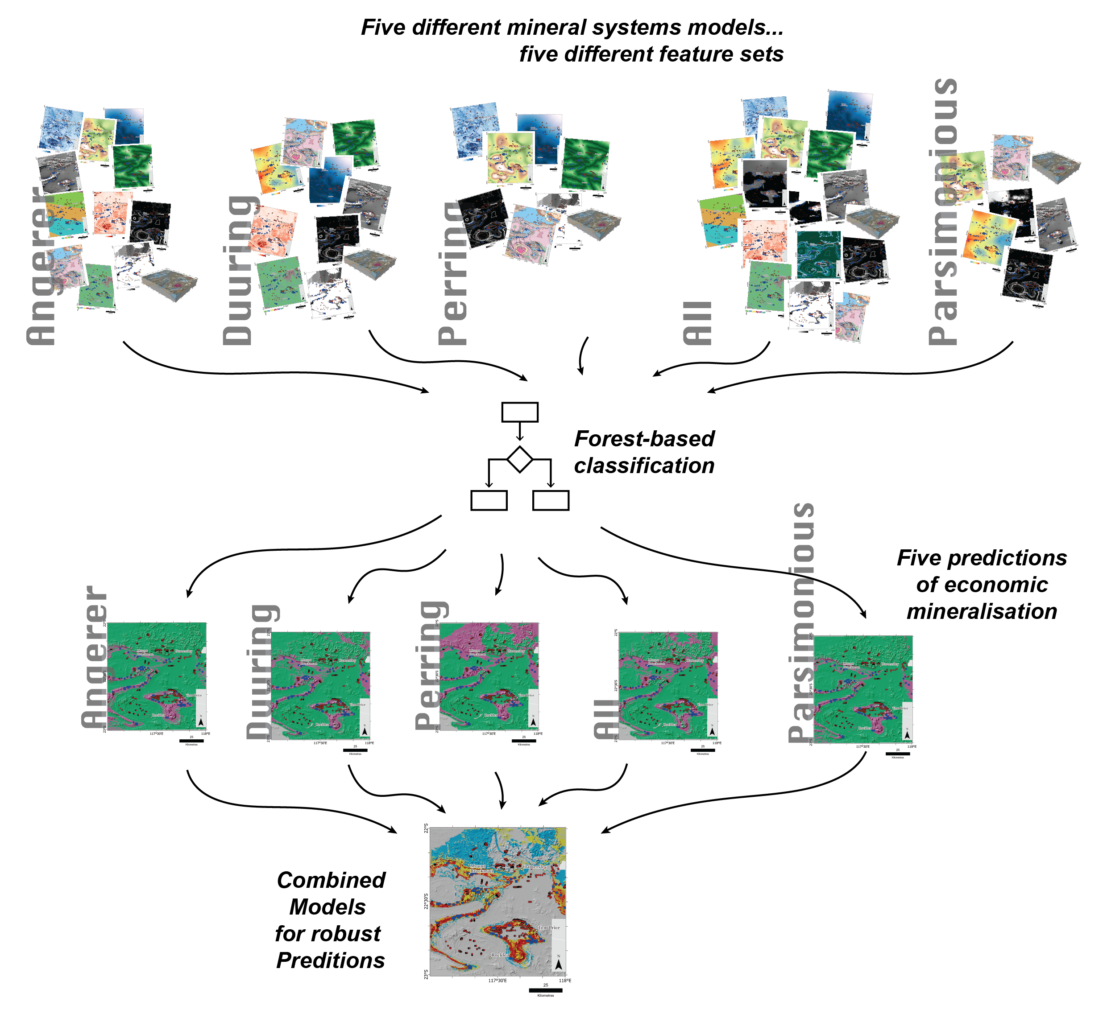
Multiple concepts, Multiple models
Model | Features (exploration criteria) | Concept
Angerer et al. (2015) | 10 | Broad synthesis of BIF-hosted Fe Ore, Hamersley and Yilgarn
Duuring et al (2016; 2021) | 9 | Multistage hypogene & supergene geothite / hematite
Perring et al (2020) | 7 | Martite-geothite specific to local region. Three stage fluid and mass flux
All | 14 | All available features
Parsimonious | 6 | The ‘top-six’ features
This is an exercise in understanding how conceptual models drive feature selection, and impact on feature and model performance
This is not an exercise in falsifying conceptual models, or establishing which is ‘best’

Slide 7
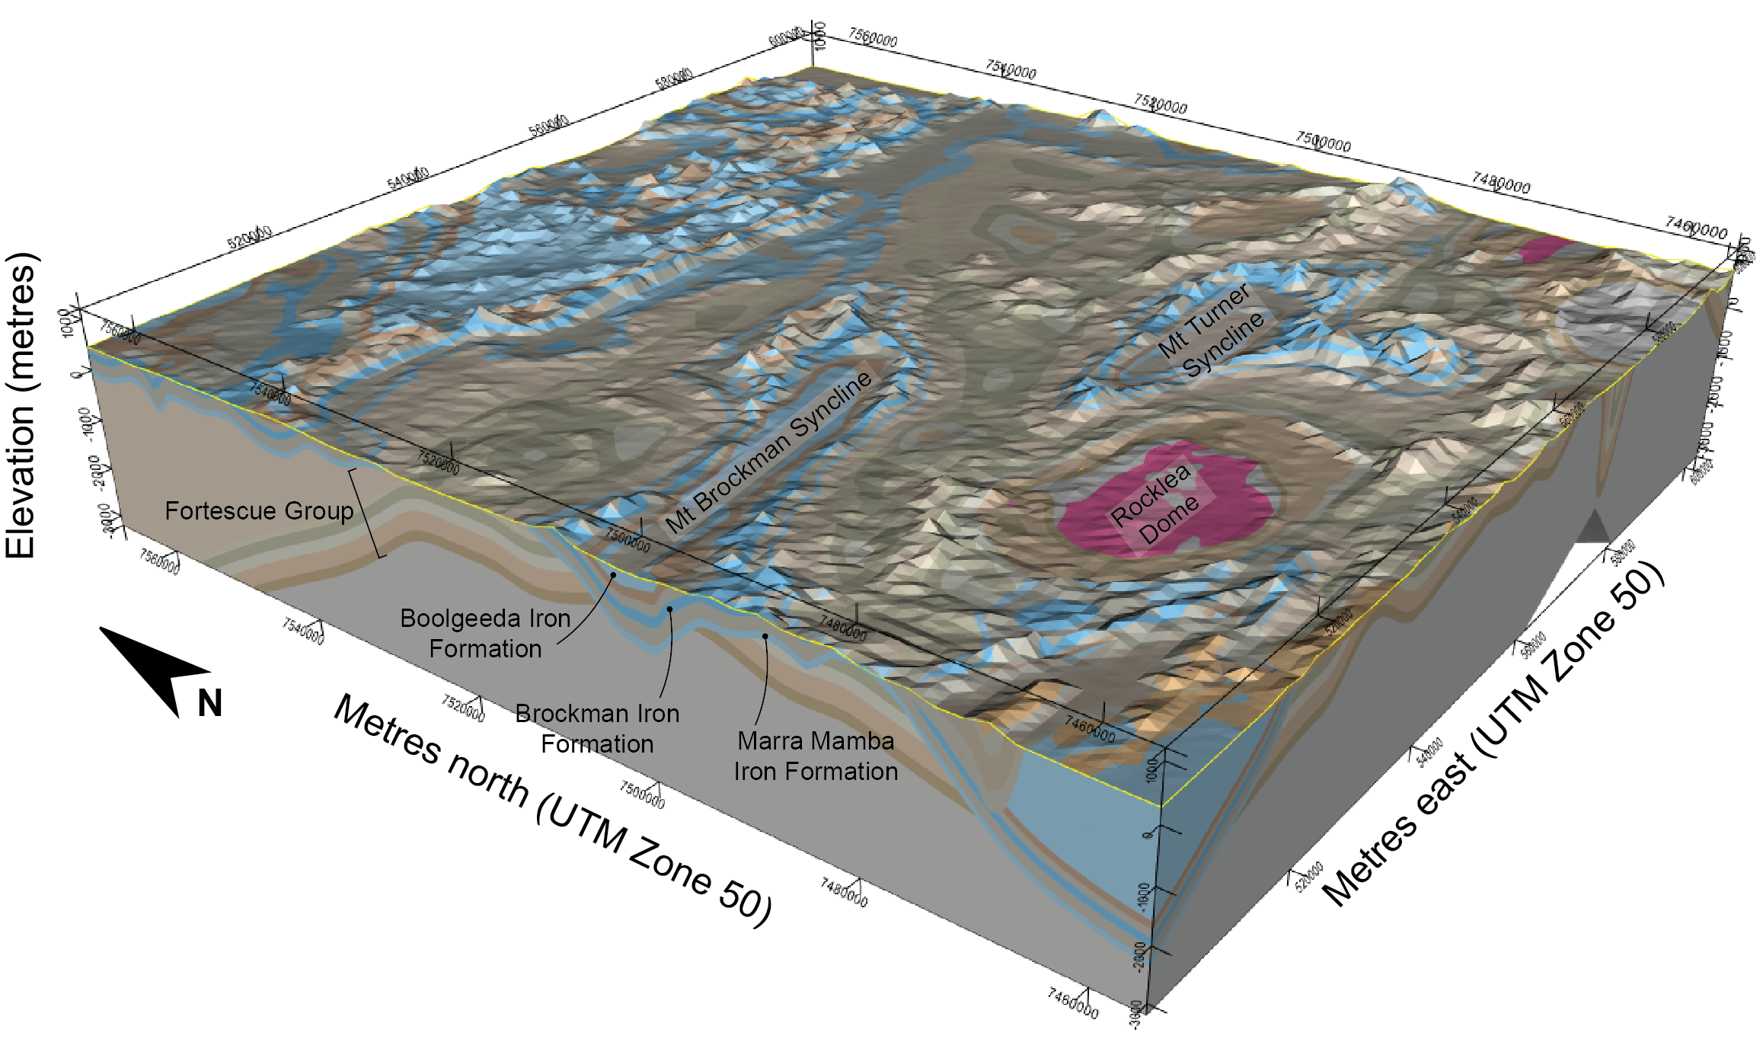
Models
Forest-based classification
Deposit locations
(Positive examples)
Gravity
<= 1000 μm/s²
False: 10, True: 90
map2loop / map2model
Dip angles
Isopach thickness
Stratigraphic thickness
RTP
<= 10k nT
False: 0, True: 10
Distance from fault
<= 5 eK %
False: 35, True: 55

Slide 8
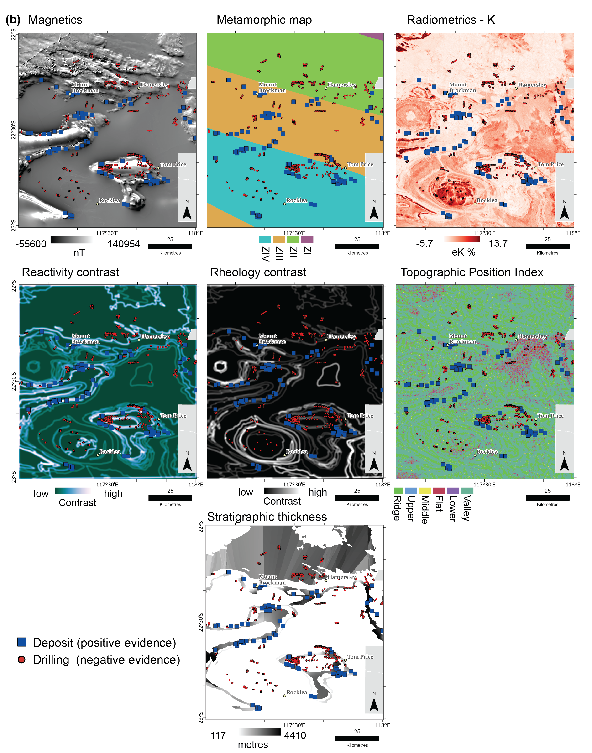
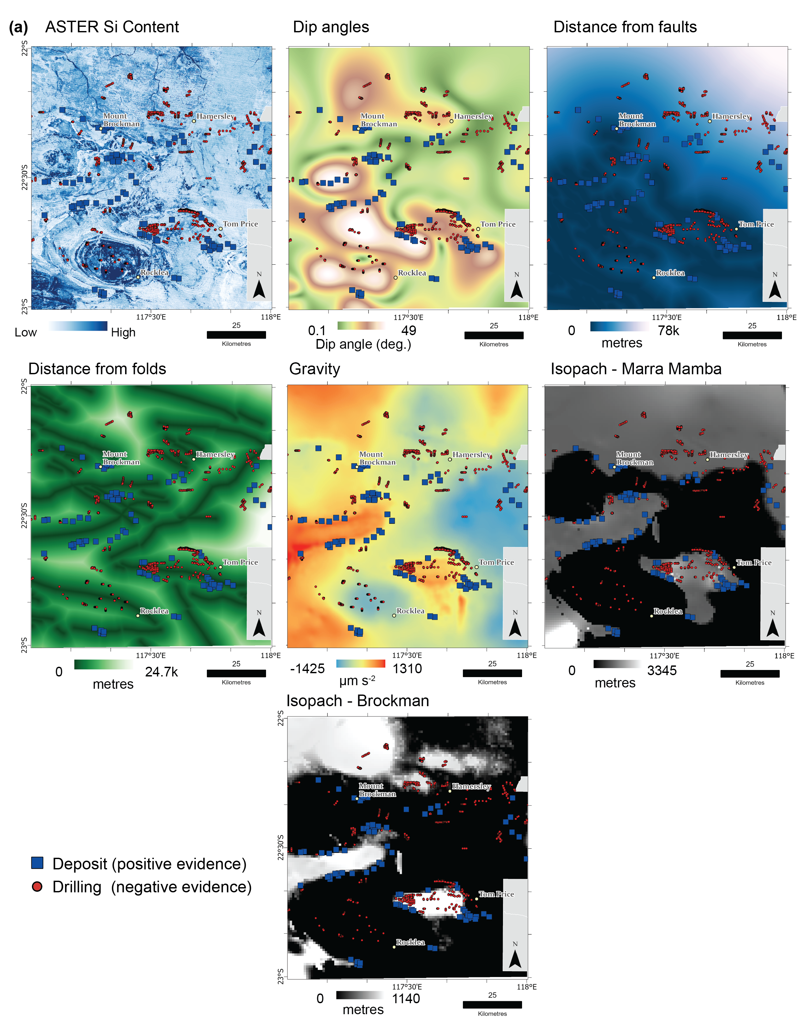
Features
Our digital representation of geological phenomena

Slide 9
Notes:
An isopach map displays lines of equal thickness in a layer where the thicknesses are measured perpendicular to the layer boundaries. Isopach maps are also referred to as True Stratigraphic Thickness (TST) maps.
An isochore map displays lines of equal thickness in a layer where the thicknesses are measured vertically. Isochore maps in geology are also referred to as True Vertical Thickness (TVT) maps

Slide 10
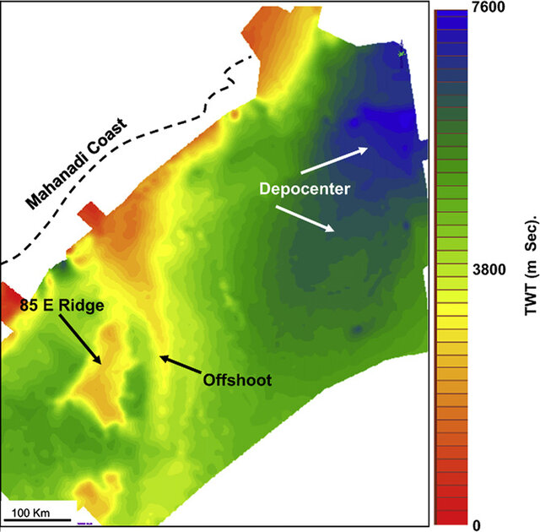
Isopach estimate
Usually thickness of sedimentary layers
Takes into account inclined angle of bedrock
(Isochore assumes horizontal)
Bastia et al 2010

Slide 11
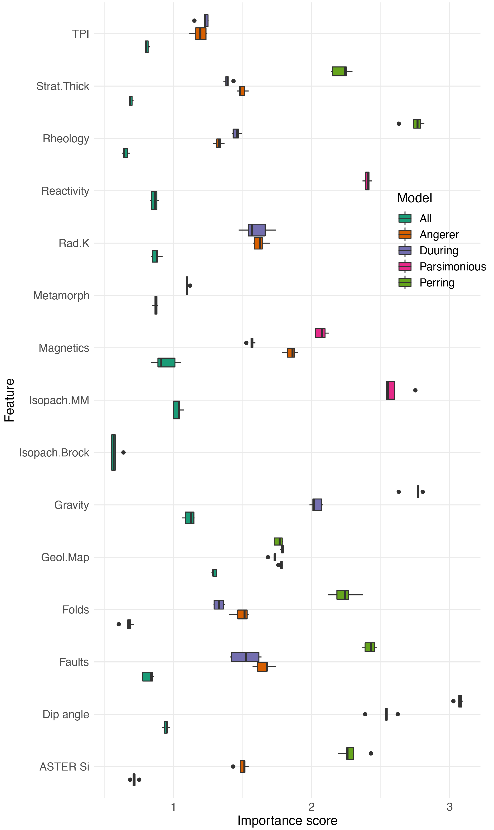
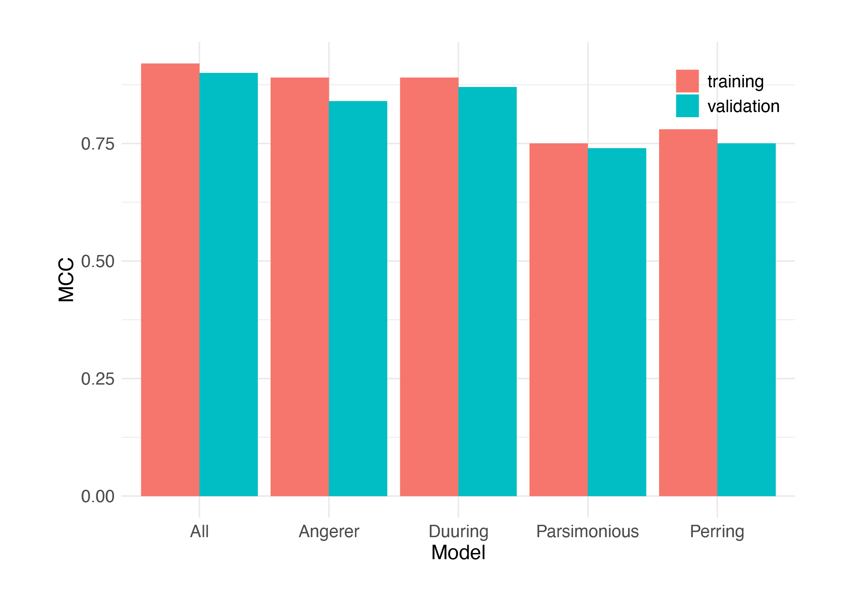
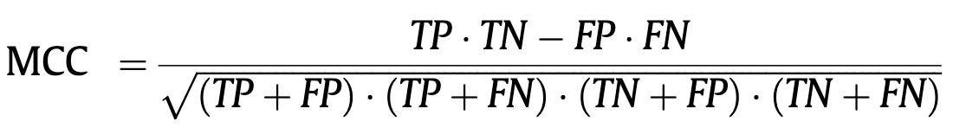
Model performance
Matthews Correlation Coefficient
When classification performance is crucial for
positive (deposits) examples
negative (non-economic drilling) examples
Chicco et al. 2021

Slide 12
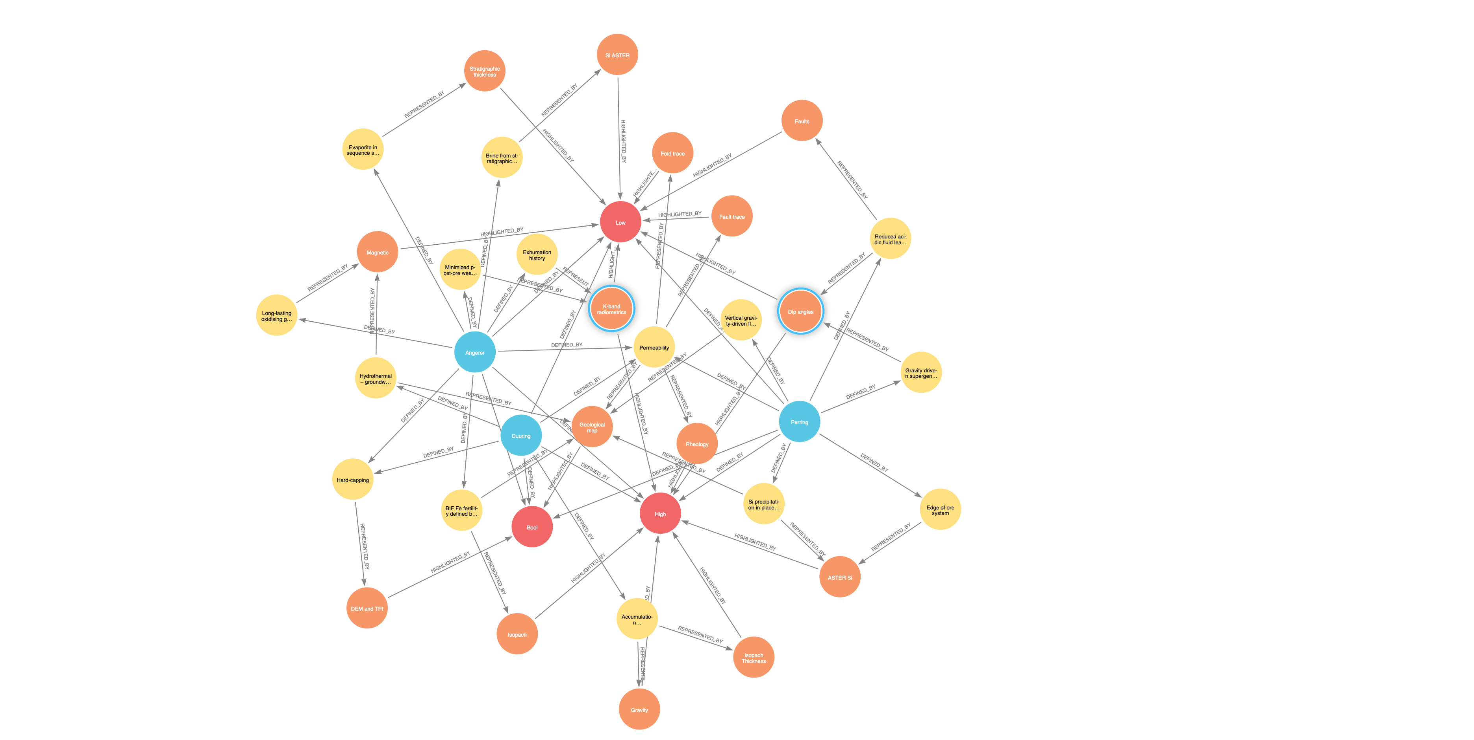
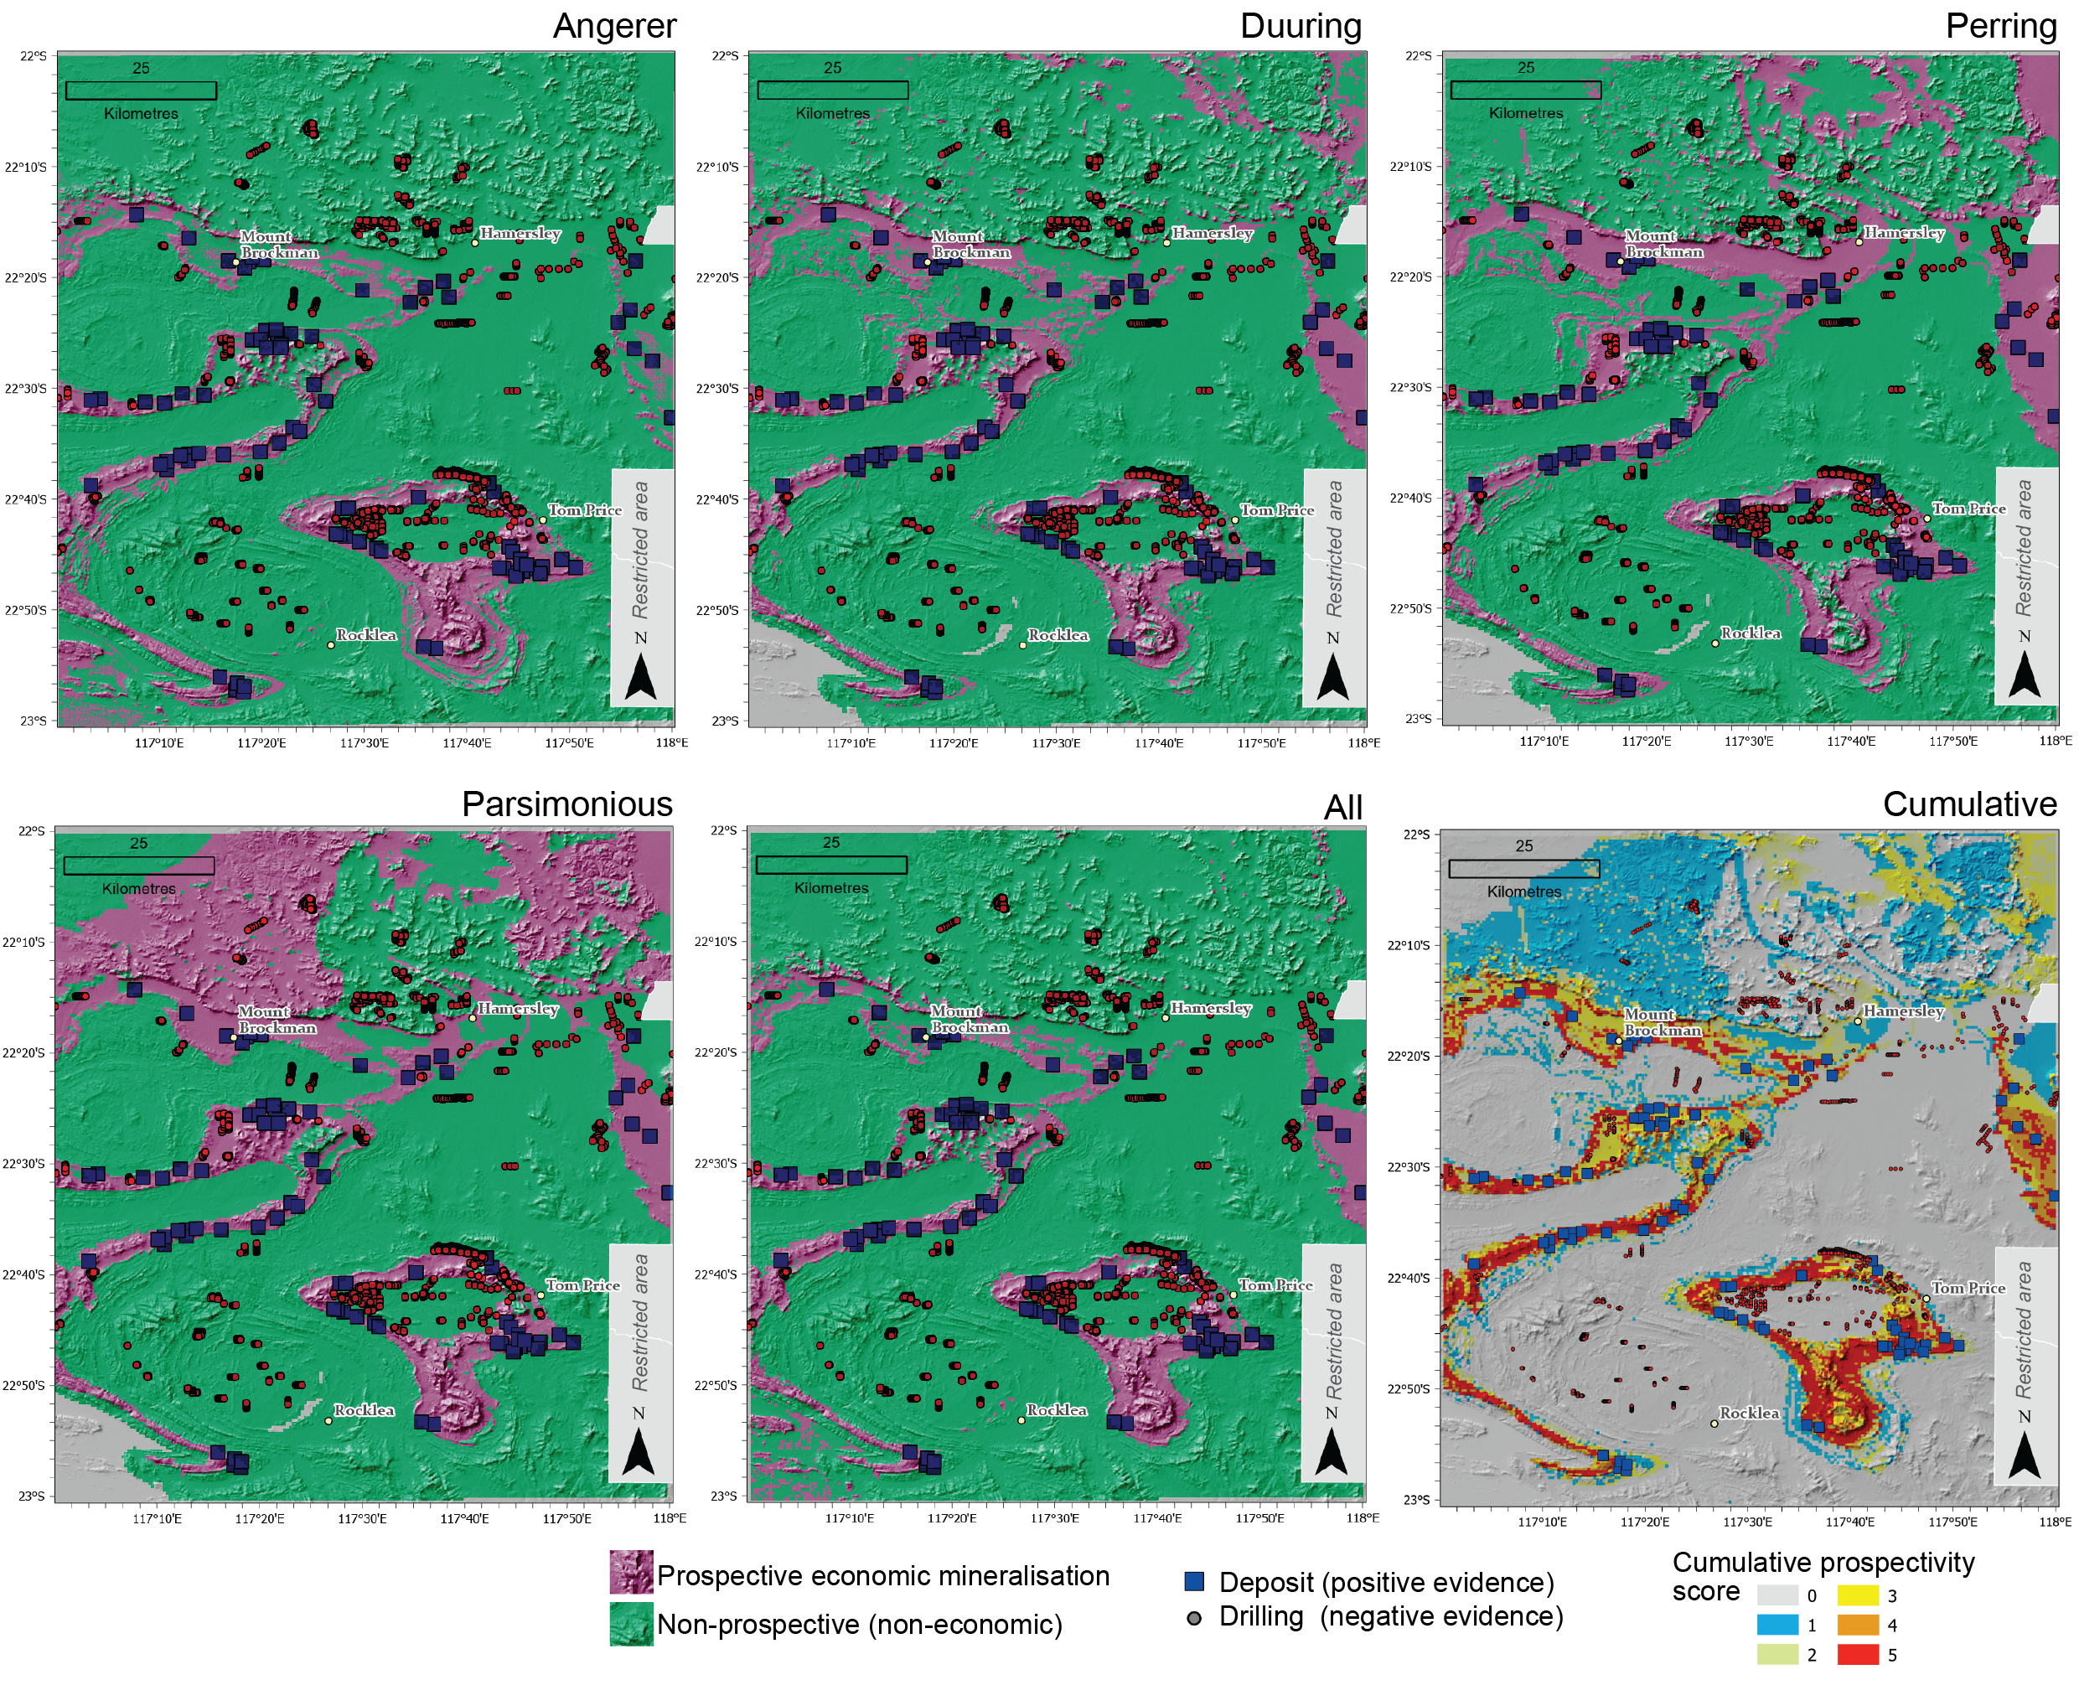
Features
Prediction
Lindsay et al (2022) GSF

Slide 13

Prediction
Features
Lindsay et al (2022) GSF

Slide 14
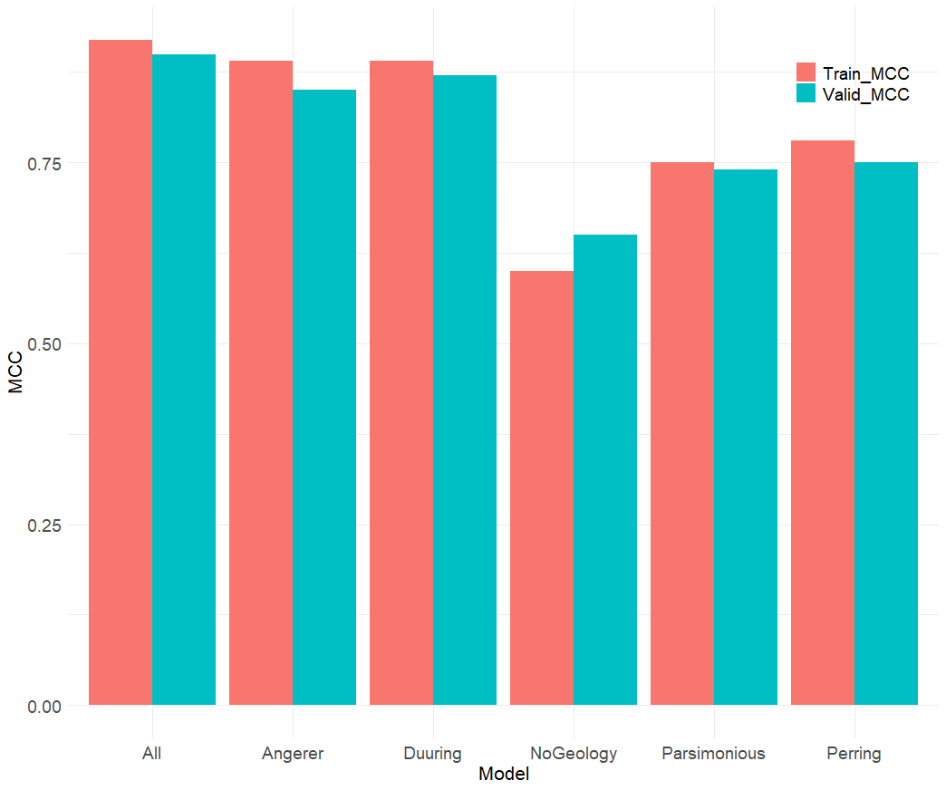
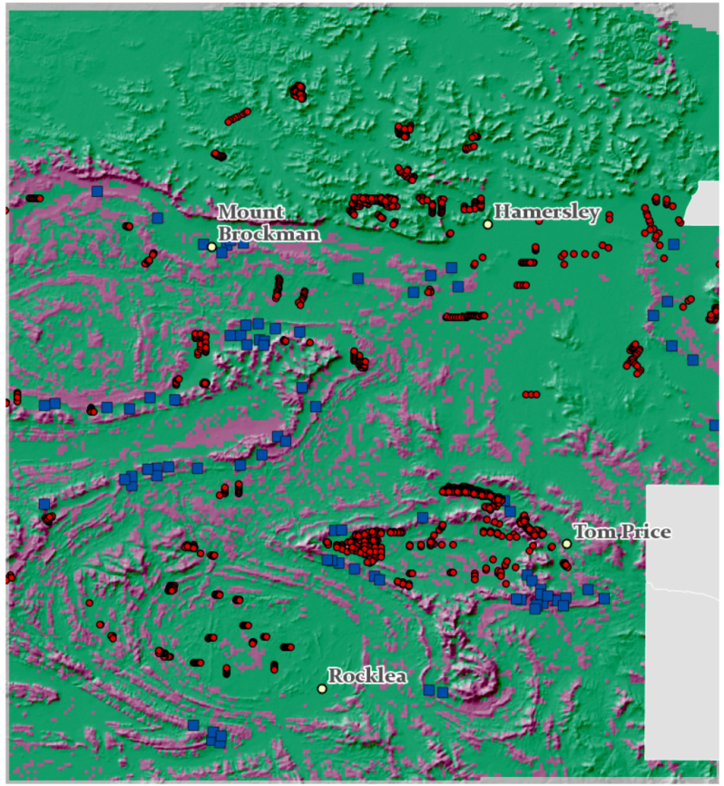
Model performance – no geological map
NoGeology

Slide 15
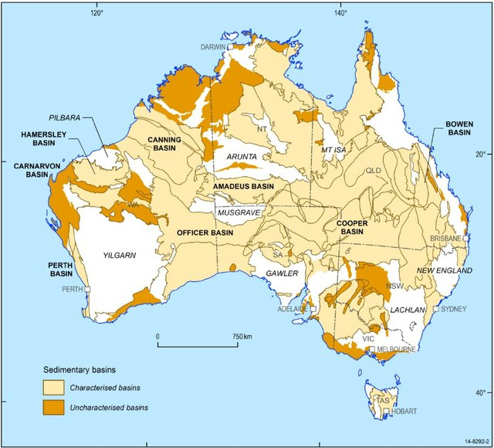
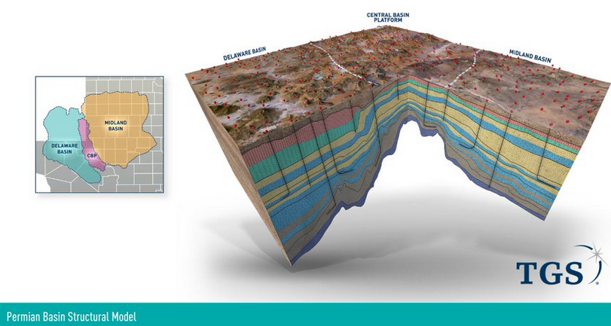
Basins
Typical prospectivity studies largely fail in flat-lying basin terranes
Taking a top-down map view disallows important geometries to be detected
3D representation in 2D features is required
Haynes et al 2015
Notes:
Characterised for geothermal potential – but the point is the much of Australia (the coloured bits) are basins.

Slide 16
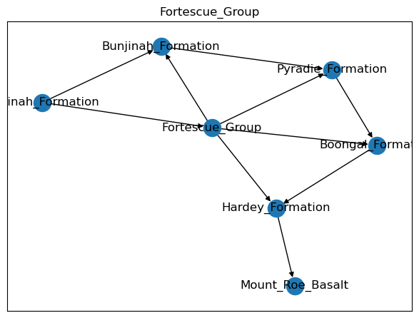
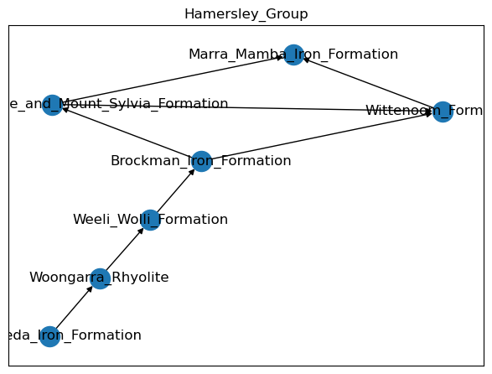
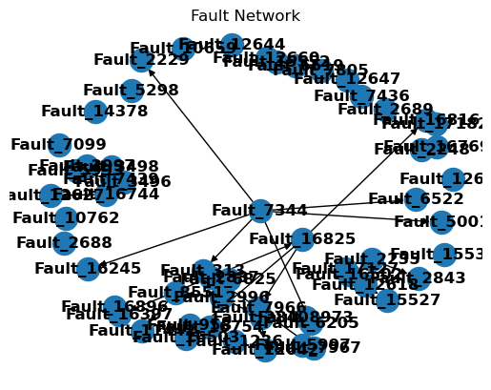
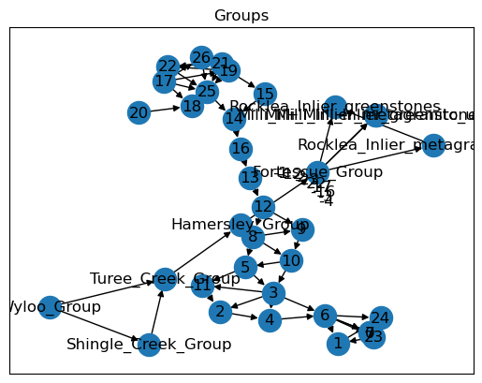
Geological topology

Slide 17
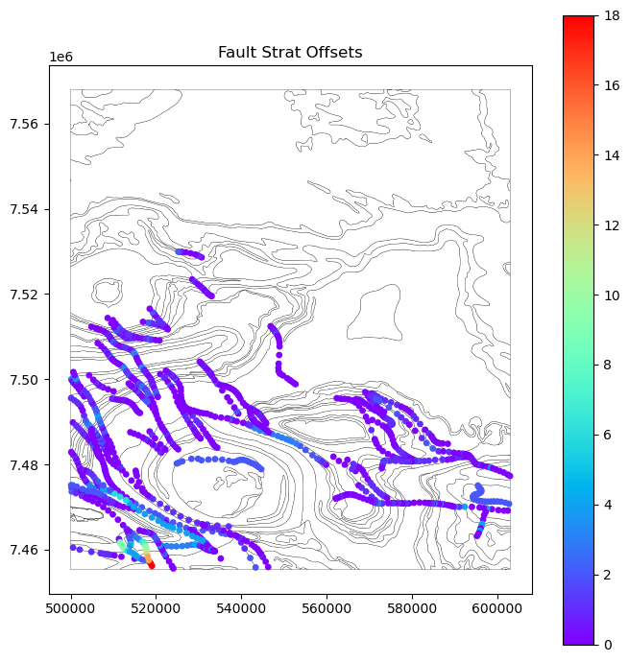
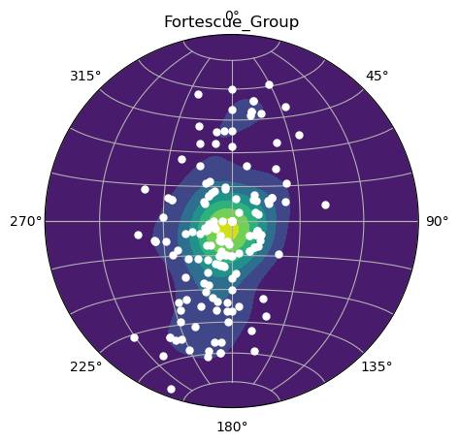
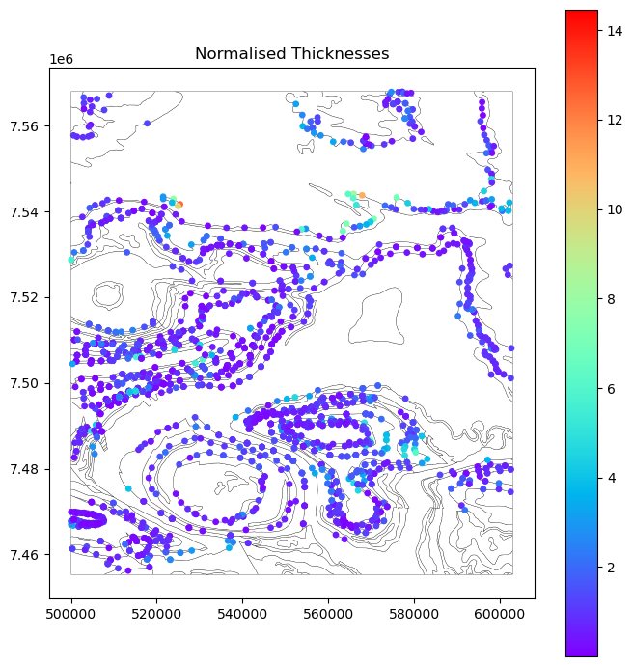
Structural Geology

Slide 18
Conclusions
3D derived features from map2loop can provide important prediction support
Predictions are sensitive to conceptual models
Exploration criteria (feature) importance changes
What we need:
rapid knowledge extraction (NLP) methods to generate conceptual models (knowledge representation)

Slide 19
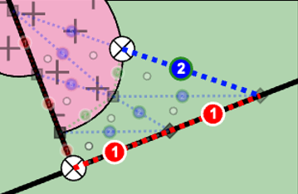
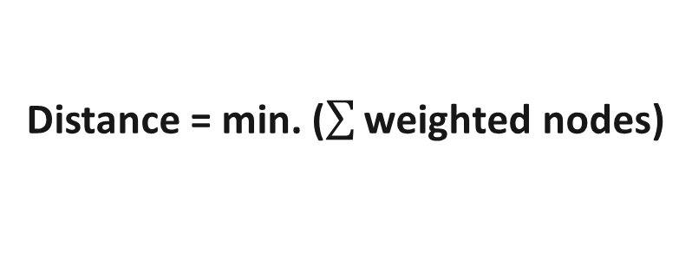
Fluid travel paths and distance Non-Euclidean distance
B
Weight | Feature
1 | Deformation zone (trans-crustal)
2 | Deformation zone (secondary splay)
5 | Unconformities
5 | Intrusive contacts
6 | Conformable volcanic contacts
6 | Chemical sed. (BIF/chert)
7 | Clastic sedimentary
7 | Felsic volcanic
8 | Ultramafic/Mafic volcanic
10 | Intrusive body (all compositions)
Fast
Fault
Deformation zone
A
Slow
Distance = min. ($\sum{\text{weighted} \text{nodes}}$)
Montsion 2023
Notes:
Source
Fluid
Metal
Ligand
Pathway
Porous lithology
Structural conduit
Trap
Mechanical
Chemical

Slide 20
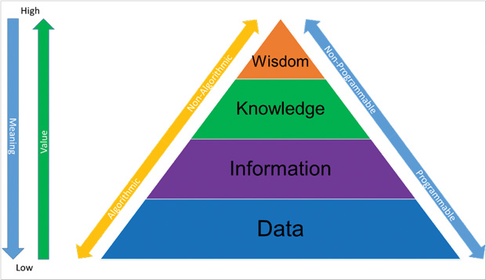
A reminder – ‘DIKW’ diagram
The knowledge and wisdom gained from this process is often lost and can be the most valuable
Defining geodynamic setting with interp.
Testing 3D model with drill targeting
Integrated geological interpretation
3D model
Geophysical dataset
Drillhole logs and properties
Geological observation
Geophysical measurement
https://www.digitalengineering247.com/article/enhance-your-product-development-lifecycle/

Slide 21
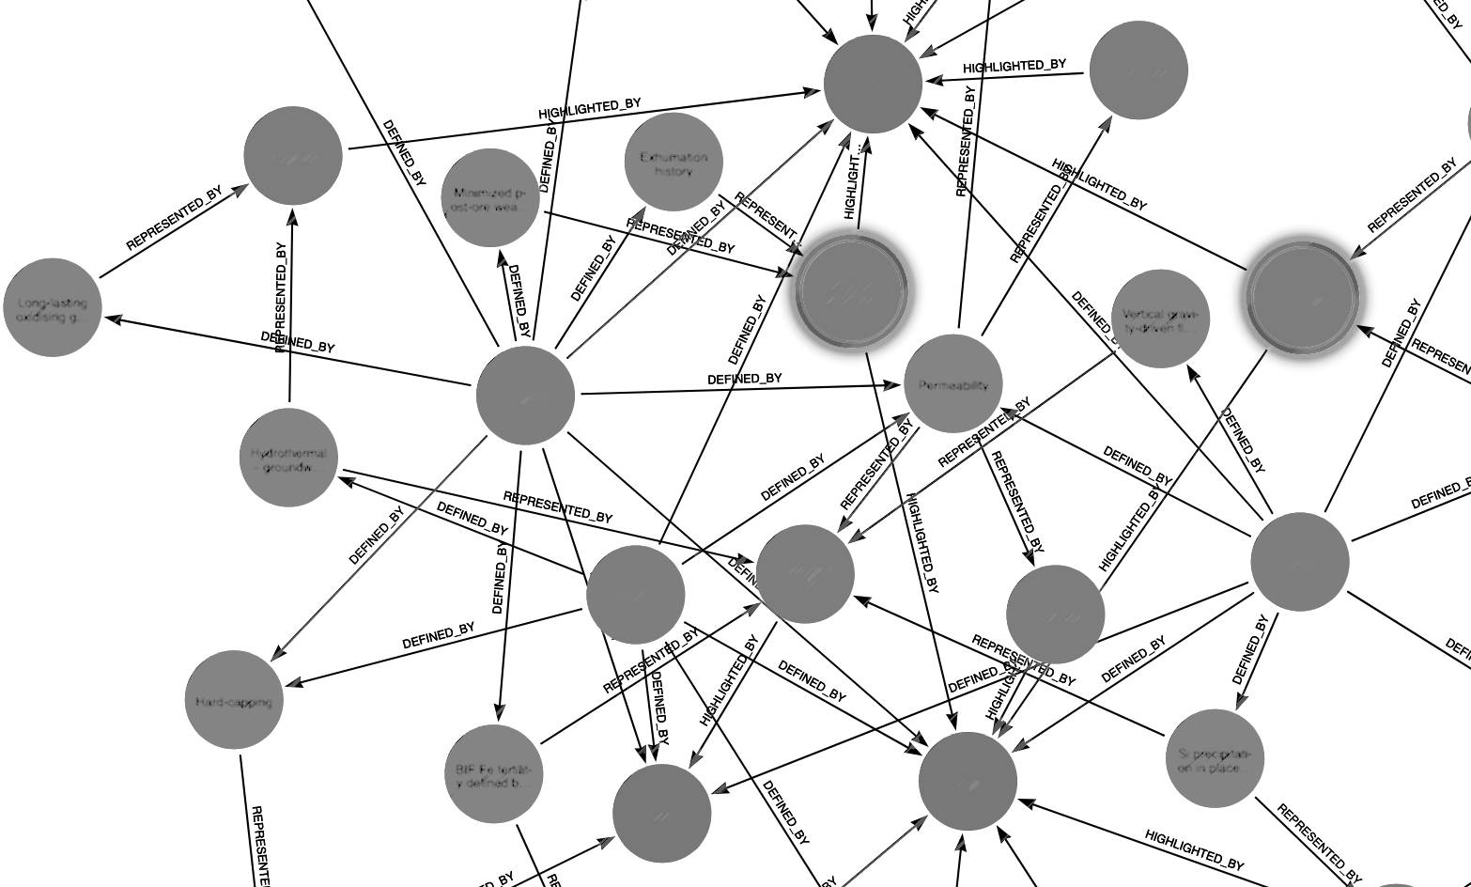
Limitations
Author
Geological
concept
Feature
representation
Property

Slide 22
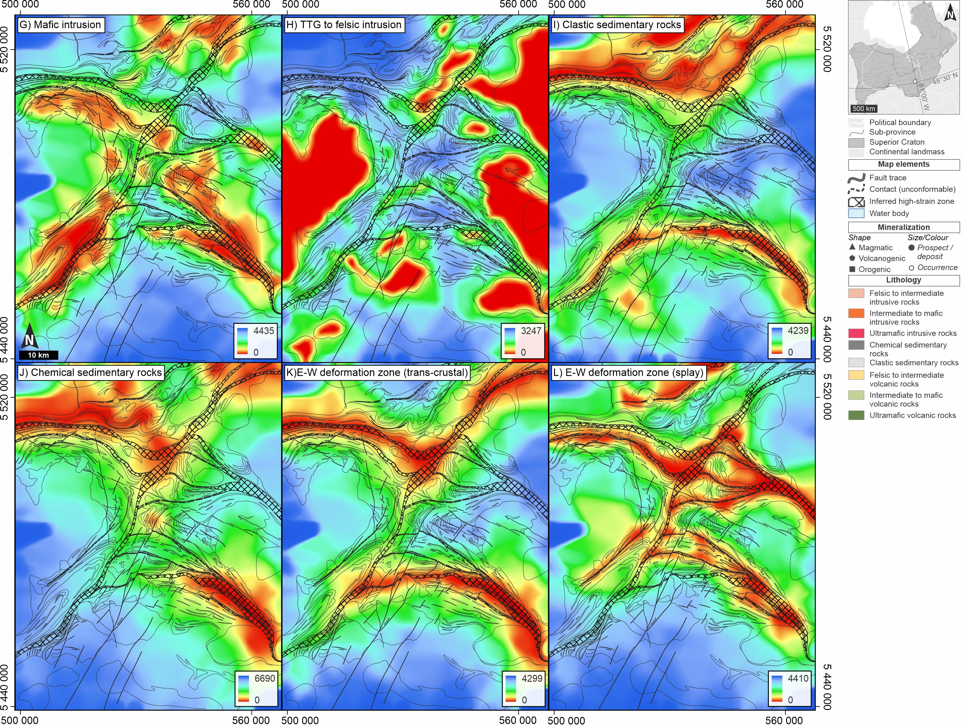
Fluid travel paths and distance Non-Euclidean distance
Far
Intrusions
aults
Close
Deformation zones
Far
2 km
Close
Montsion 2023

Slide 23
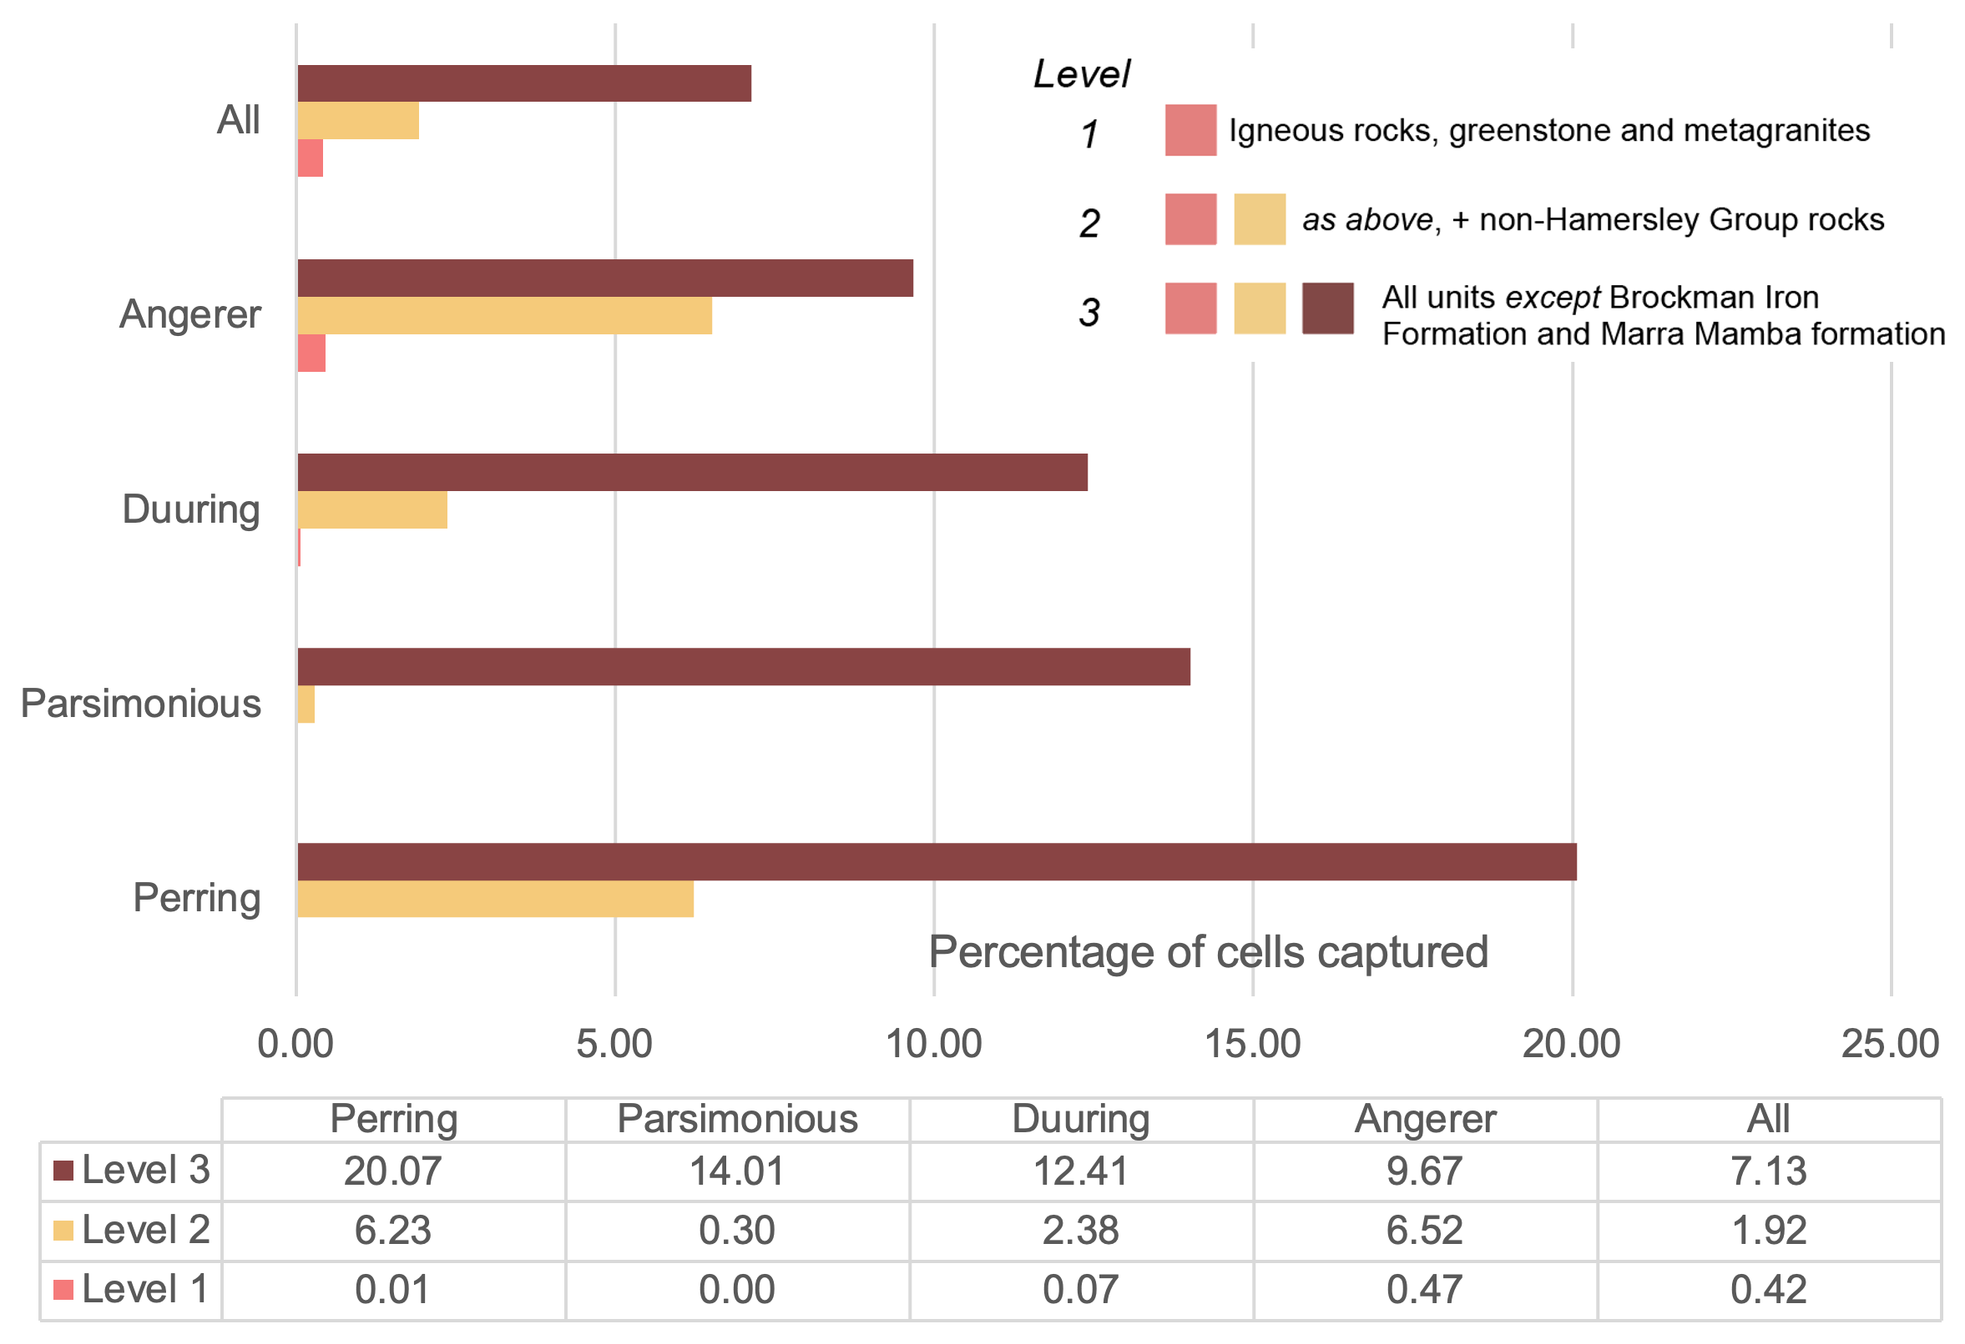
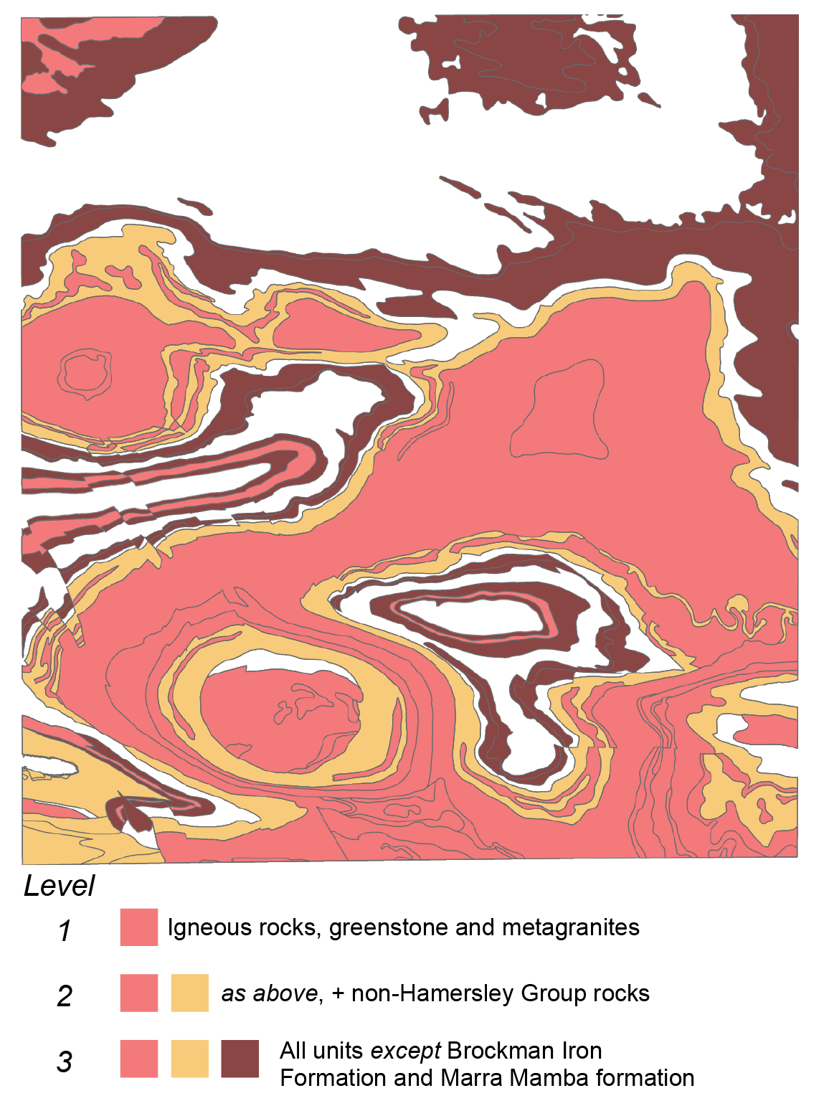
Plausibility
Question:
What percentage of predictions are in implausible locations?

